Slide 1



Multi-Feature Graph Convolutional Network for Hindi OCR Verification
BHASHA Workshop @ IJCNLP-AACL 2025
Shikhar Dubey, Sourav Kumar Behera, Krish Mittal, Manikandan Ravikiran, Nitin Kumar, Saurabh Shigwan, Rohit Saluja

Slide 2








Challenges in Hindi OCR Verification
The Problem:
Real Word Images | OCR Prediction
"Can you trust what you see?"

Slide 3
Key Contributions
Grayscale Synthesis: A technique to transform OCR text predictions.
Multi-Feature Representation: Combining semantic features with geometric features.
Novel Patching Strategies: Evaluation of multiple segmentation strategies.

Slide 4
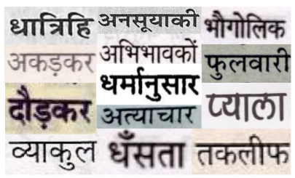
Dataset Preparation
Synthetic Training Data (for OCR model):
10 million images generated using 900+ Hindi fonts.
Includes realistic degradations .
Real-World Testing Data:
1000 books use to ensure diversity.
Split: 80% Training, 10% Validation, 10% Testing.

Slide 5
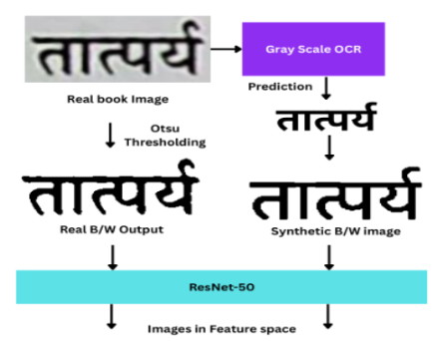
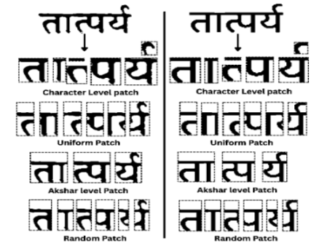
Segmentation Strategies
Hindi Challenge: Complex conjuncts make standard segmentation hard.
Akshara-level Patch
Linguistically meaningful syllables
Connected component analysis + linguistic rules
Character-level Patch
Finest granularity
Individual characters including conjuncts
Uniform Patch
Equal-sized segments
Assumes uniform spacing
Random Patch
Random intervals
Lower-bound reference

Slide 6
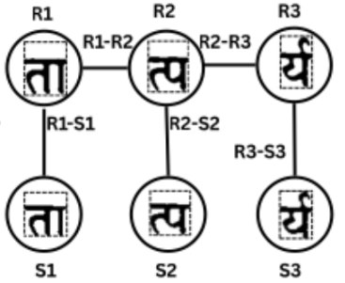
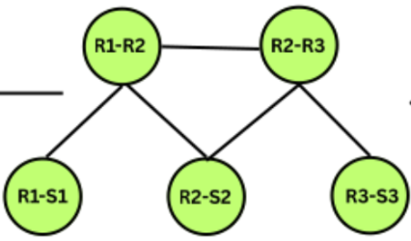
Graph Construction
Node Features (The "Stability" Vector): Each node contains a vector capturing:
Geometric: Hu Moments (Shape), Pixel Count (Size).
Semantic (Cross-Entropy): Measures "Visual Stability."

Slide 7
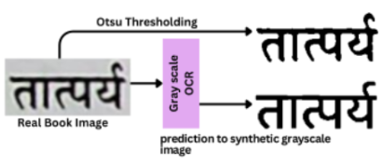
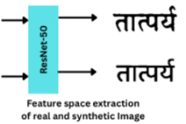
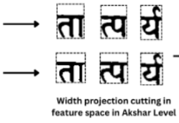

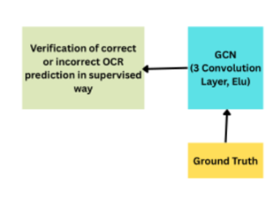
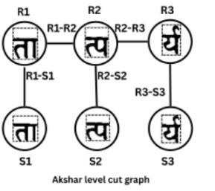
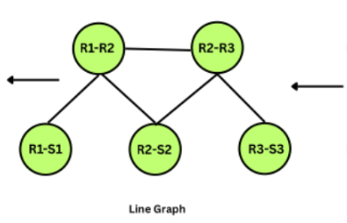
System Overview
Key Steps:
Real book image → OCR prediction → Synthetic grayscale rendering → ResNet-50 feature extraction → Width Projection Cutting → Character Graph → Line Graph → GCN-based verification

Slide 8
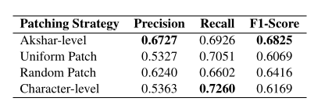
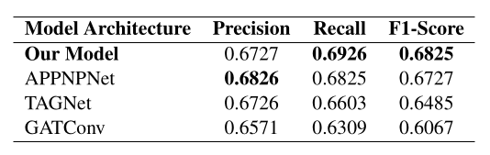
Results
Architecture Comparison
Patching Strategies
Takeaways:
Our model achieves the highest Precision (0.7357).
Key Takeaways:
Akshar-level is the best balanced strategy (Highest F1).
Character-level has the best Recall (0.7260)

Slide 9
Conclusion and Future Work
Conclusion:
Summary: We presented a GCN-based verification framework that effectively detects OCR errors in Hindi text using Real-Synthetic visual comparison.
Findings:
Aligning segmentation with linguistic units (Akshara) is critical for performance.
Geometric features (Hu Moments) combined with semantic features provide robust verification.
Future Work:
Extend to Handwritten Text Recognition (HTR).
Extend to other Indic scripts (Bengali, Tamil, etc.)

Slide 10
Thank you

